Slide 1
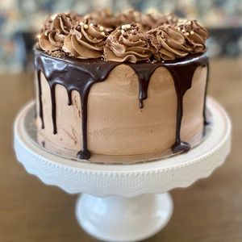
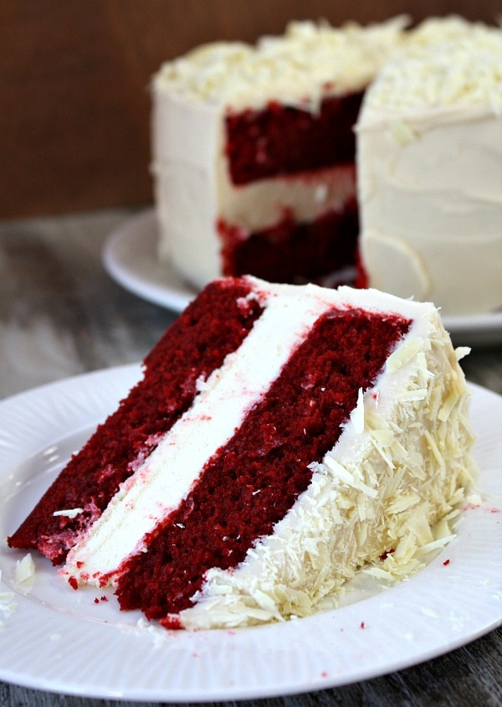
Welcome to our online cake shop
Life is short eat our cake and make every moment a celebration!
Cake shop

Slide 2





Team , Money Makers
Sanaa Obied
Ahed Ghnimat
Qusai Jaber
Mohand Idrees
Rayan Ghnimat
Manager
Secretary
Technical architect
Programmer
Tester

Slide 3
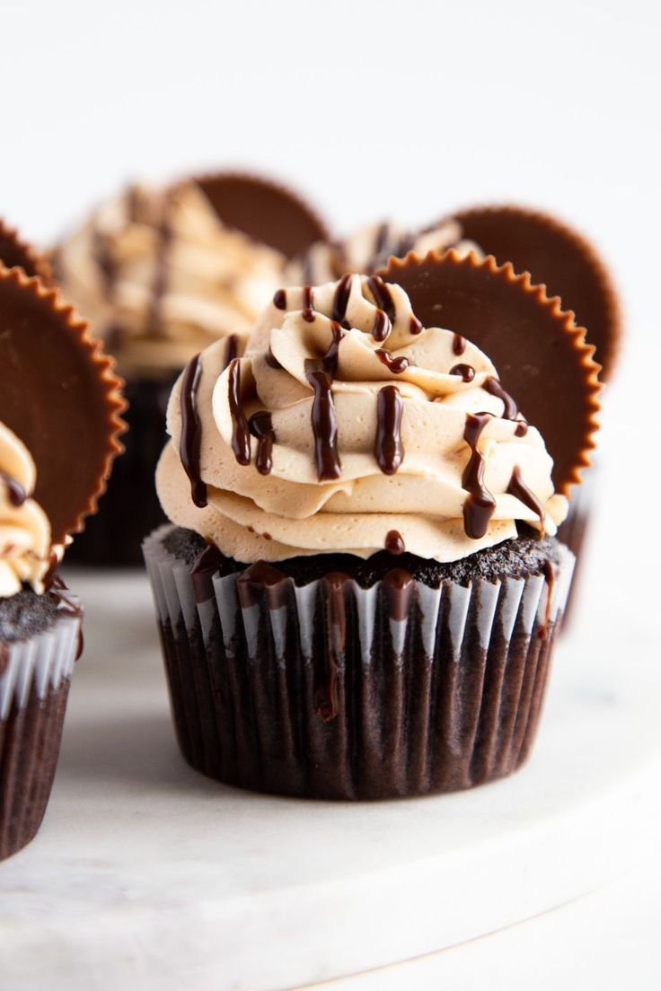
Chapter
Two

Slide 4
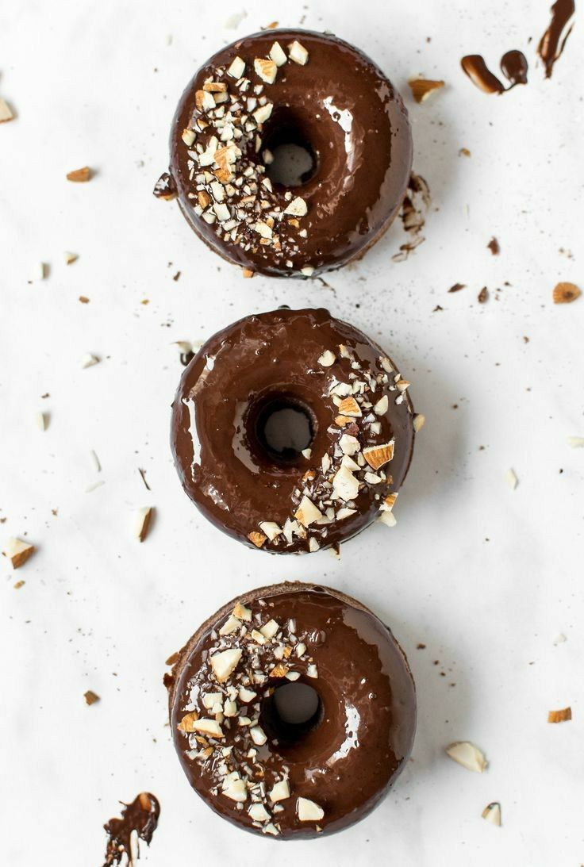
Cake Shop
User-friendly website with a diverse cake catalog.
Easy selection and customization of cakes; optional account creation.
Secure online payment and confirmation email upon payment.
Collaboration with local bakers for fresh cake delivery.
Encourages customer feedback; support available via email or phone.
Focus on customer satisfaction: tasty cakes, on-time delivery, and an enjoyable shopping experience

Slide 5
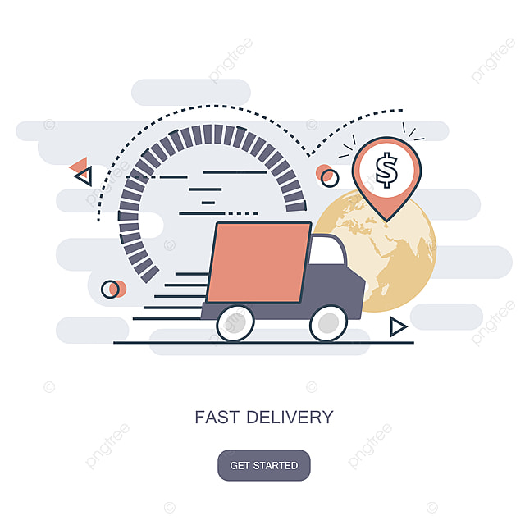
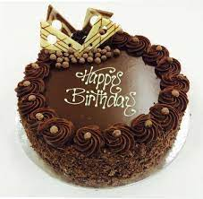
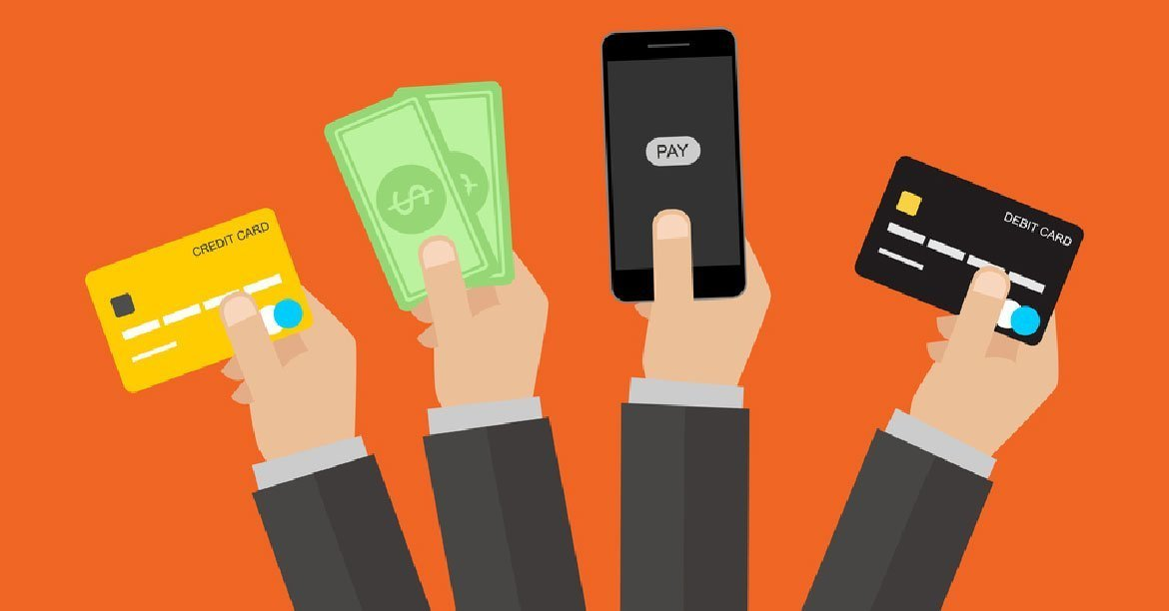

Cake Shop
Services provided by the store:
Choose the cake and
decorate it as you want
Providing feedback from the customer about the services
Pay in multiple ways
Fast delivery

Slide 6
Scenario: Customer Rating Cake
Initial Assumption:
The customer has successfully completed a purchase on the online cake shop's website.
Normal:
Email Confirmation:
After a customer completes a purchase, an automated system generates an order confirmation email.
The email includes a personalized thank-you message, a summary of the order, and a prominently displayed link to the feedback form.
Feedback Form Integration:
The link directs the customer to a dedicated page on the cake shop's website, where the feedback form is seamlessly integrated.
The website uses secure and user-friendly protocols to ensure a smooth transition from the email to the feedback form.
User-Friendly Feedback Form:
The feedback form is designed with a clean and intuitive user interface.
Clear fields are provided for the customer to rate specific aspects of their experience, such as product quality, delivery time, and overall satisfaction.
A user-friendly rating system (e.g., stars or numerical scale) simplifies the process.
Optional Comments Section:

Slide 7
Scenario
What Can Go Wrong?
Server Downtime during Feedback Submission
Alternative: when the customer tries to give feedback using the link, they might face issues because the server is not working well. This could happen because of things like unexpected maintenance, too many people using the system, or problems with the server. When the system notices that the server isn't working, it automatically takes action by telling both the technical support team and the customer about the issue. The customer gets a sorry message for the trouble, along with an idea of when the problem might get fixed. To make sure everything goes smoothly later on, the system sends another email with the feedback link once the server is working again. This way, the customer can give their feedback when the system is stable. This problem is about the whole system having trouble, not just one specific thing going wrong, making it different from other possible issues

Slide 8
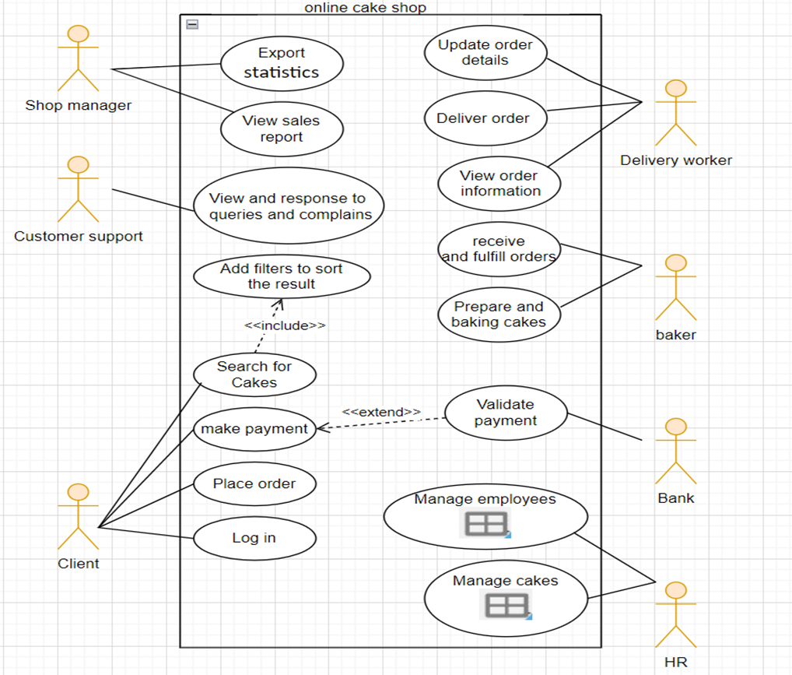
Use Case Modelling

Slide 9
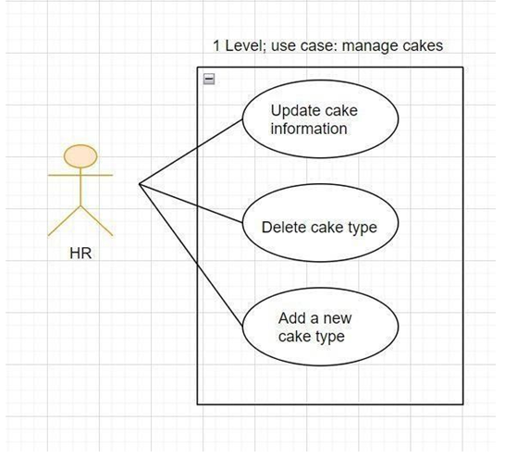
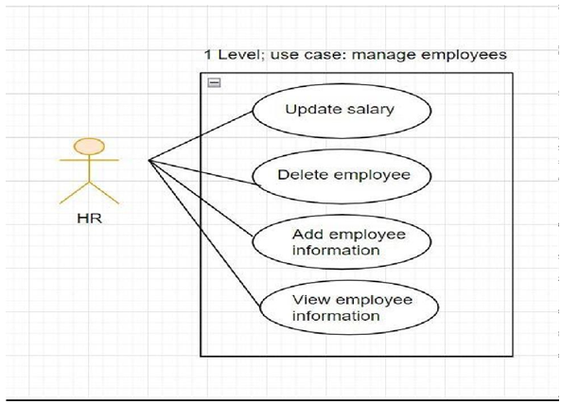
Use Case Modelling

Slide 10
Scenario Analysis :
Actors : Customer
Description: This use case involves a customer providing feedback about their experience with the online cake shop, contributing to the improvement of services and products.
Pre-conditions: The customer has completed a purchase on the cake shop's website
Sequence/Flow of Events:
After completing a purchase, the customer receives an email or notification thanking them for their order.
The email includes a link to a feedback form or directs the customer the cake shop's website
The customer clicks on the provided link, accessing the feedback form.
The system presents a user-friendly form with fields for rating different aspects such as product quality, delivery time, and overall satisfaction.
The customer provides written comments in an optional feedback section.
The system validates the feedback form and stores the provided information in the customer feedback database

Slide 11
Scenario Analysis :
Trigger : The customer receives a post-purchase communication containing a feedback request
Post-conditions/ Response:
The feedback is recorded in the system's database for analysis.
If issues are highlighted, the system may trigger an alert for customer support to follow up.
The customer may receive a thank-you message acknowledging their feedback.

Slide 12
Scenario Analysis :
Comments:
This use case allows the cake shop to gather valuable insights into customer satisfaction and areas for improvement.
Providing an optional comments section encourages customers to share specific details about their experience.
Regularly analyzing customer feedback helps the cake shop enhance its products and services.

Slide 13
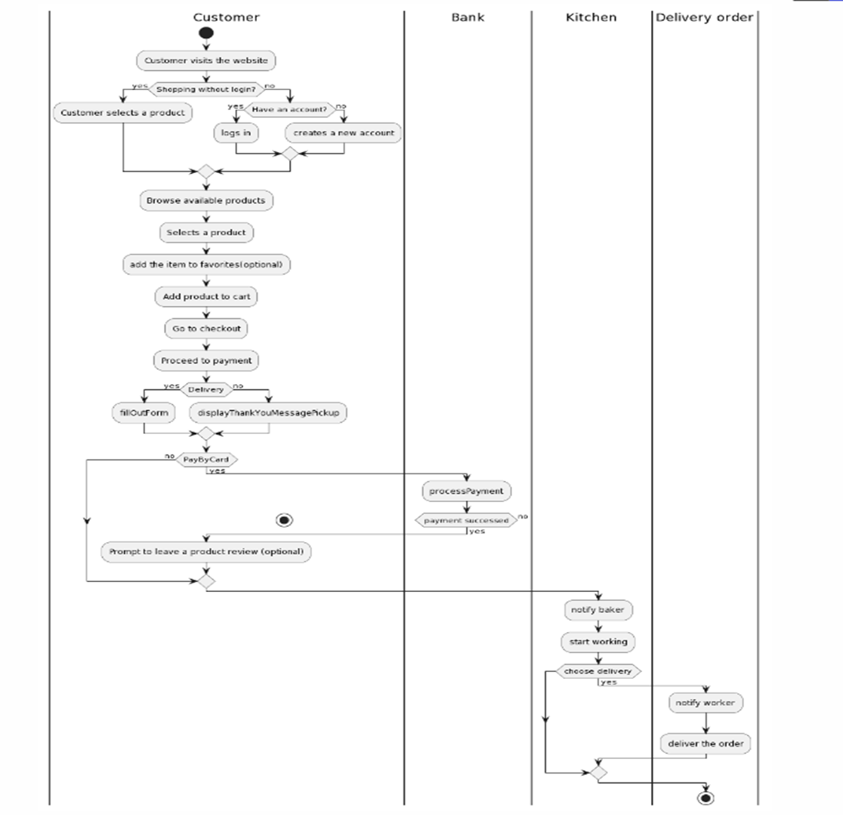
Activity Modelling

Slide 14
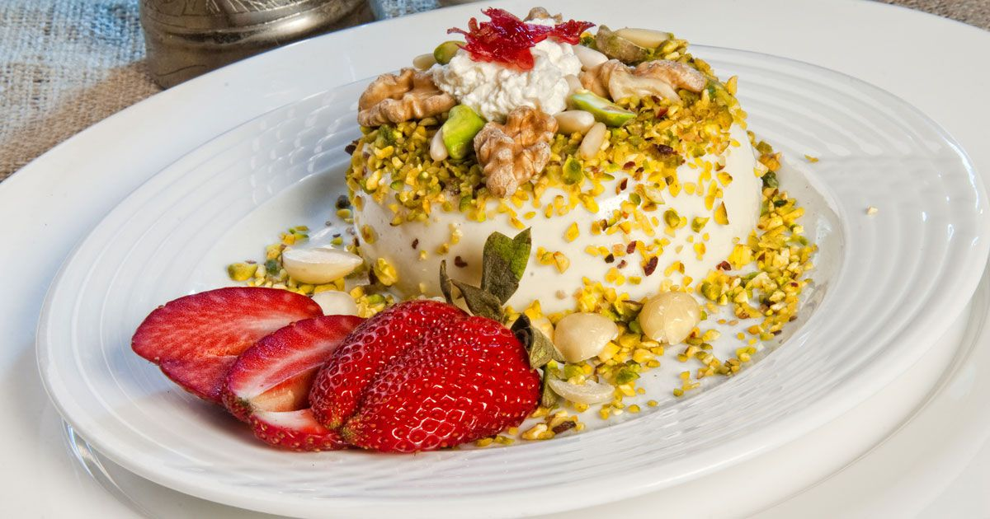
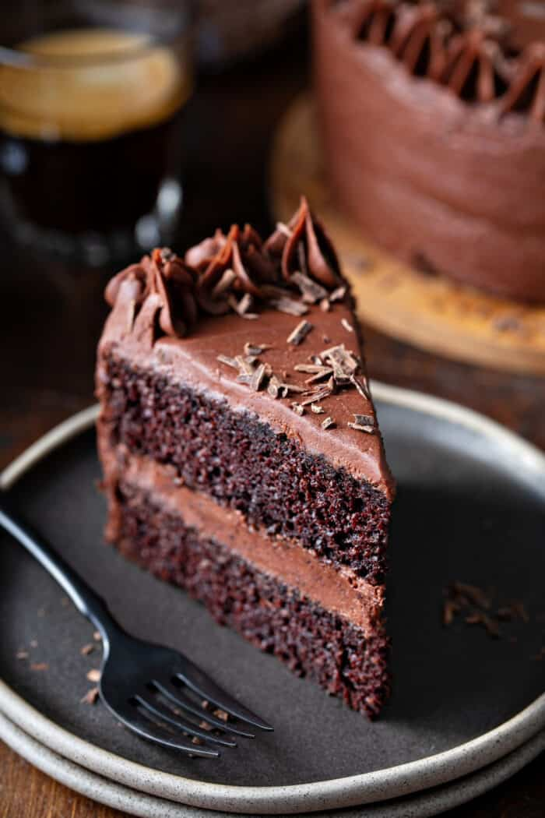
Some of our Cakes
Some of our cakes

Slide 15
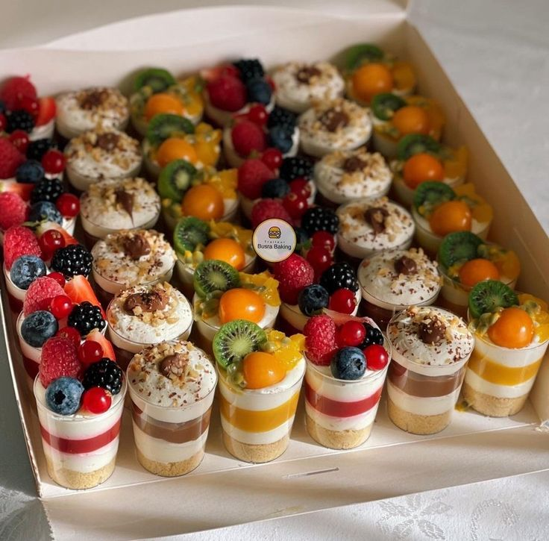
Chapter Four

Slide 16
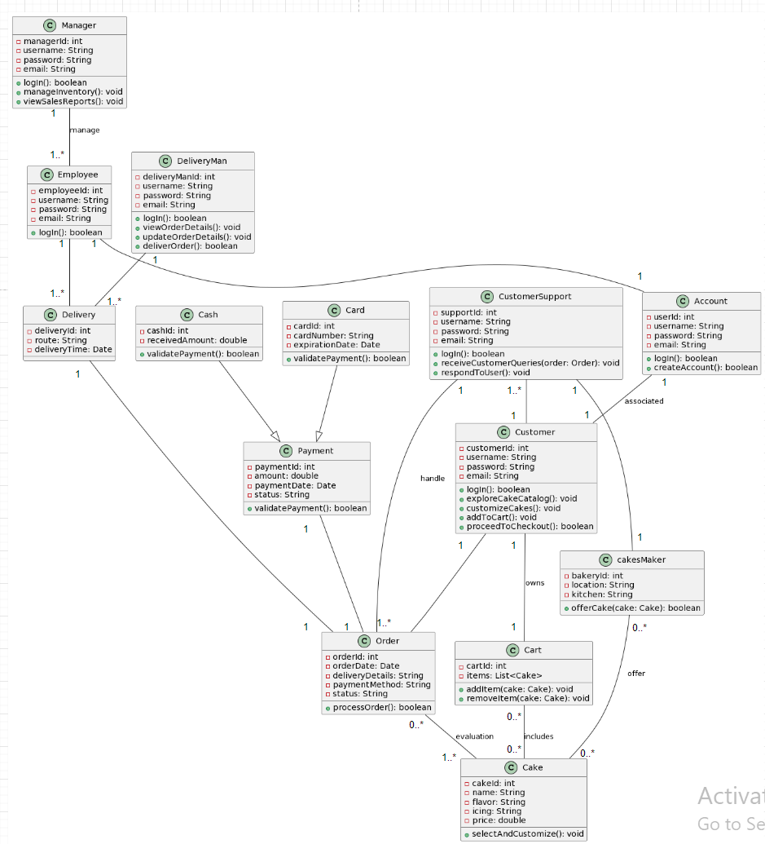
Overall Class
Diagram

Slide 17
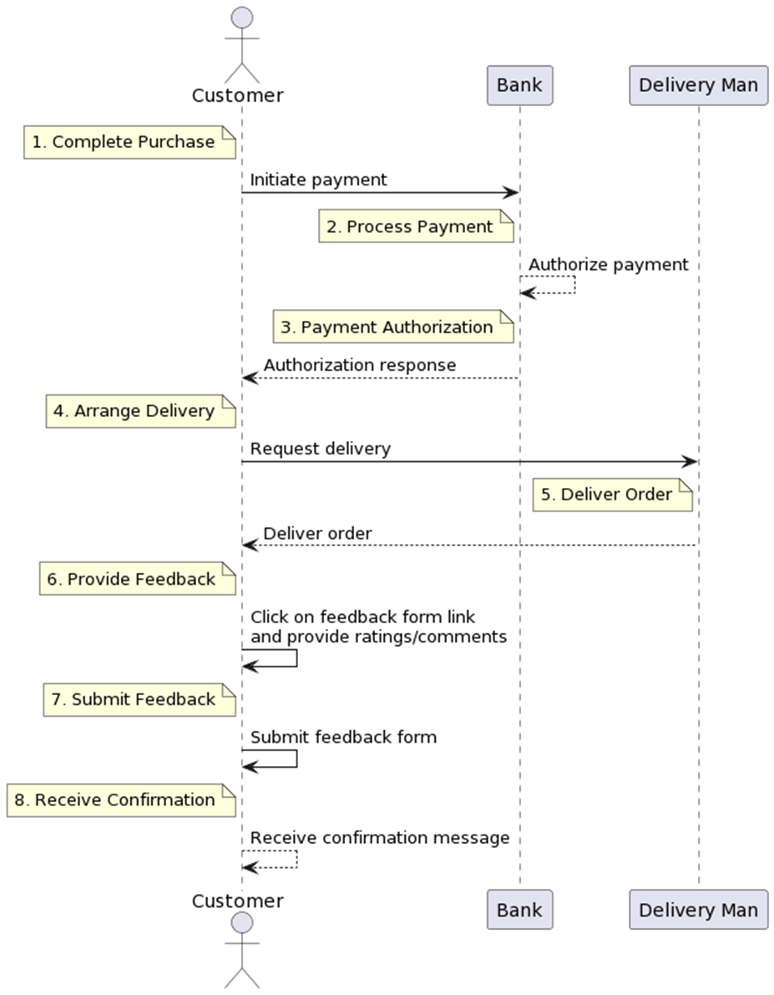
Sequence diagram

Slide 18
Design goals
General Design Goals:
1- Low Coupling
Objective: Minimize interdependencies to enhance flexibility and maintainability.
Implementation: Design classes and components strategically, highlighting benefits for adaptability and seamless enhancements.
2-High Cohesion:
Objective: Organize system components with a focus on distinct functionality to reduce complexity.
Implementation: Recommend separation based on unique functionalities, emphasizing benefits for better system manageability.

Slide 19
Design goals
General Design Goals:
3-Scalability:
Objective: Design the system to handle an increasing number of users, orders, and data without compromising performance.Implementation: Utilize scalable architecture, such as cloud services, and implement load balancing to ensure the system scales seamlessly with growing demand.
Specific System Design Goal:
4-User-Friendly Interface:
Objective: Ensure a user-friendly interface for seamless navigation and an enjoyable customer experience.
Implementation: Conduct user experience (UX) studies to understand customer preferences. Design an intuitive and visually appealing interface with easy navigation. Implement responsive design for compatibility across different devices. Provide clear and concise messaging to guide users through the ordering process.

Slide 20
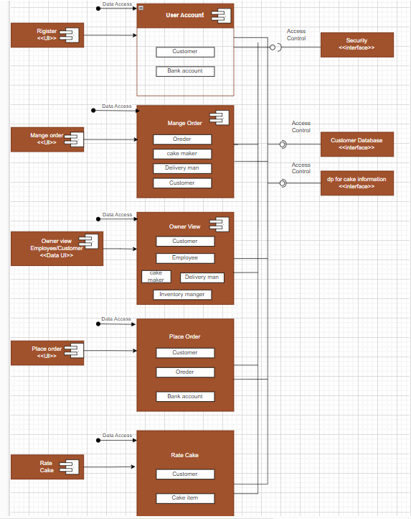
Component
diagram

Slide 21
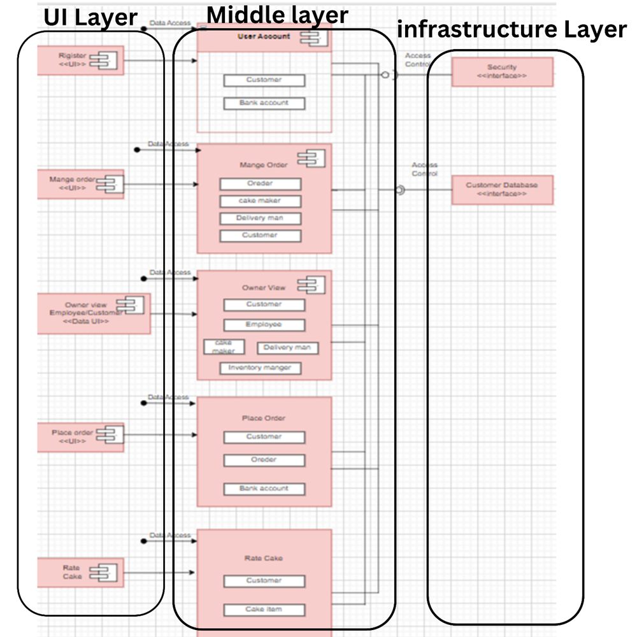
Architecture diagram

Slide 22
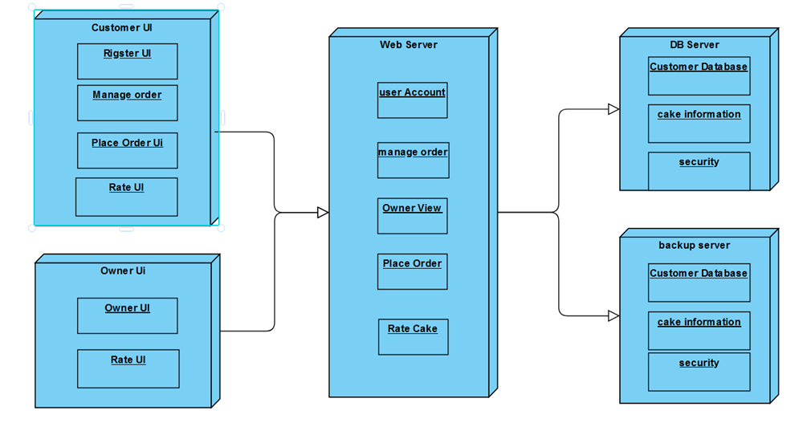
Architecture diagram

Slide 23
Thanks for watching
Hope you liked it !

